Slide 1


Computer Vision BS (CS) Elective
Instructor: Dr. Mohammad Asif Khan
asif.khan@iba-suk.edu.pk
Week 2-3

Slide 2
Unit 01 Week 02-03 Traditional Computer Vision

Slide 3
Contents
Introduction to Color Spaces
Grayscale
RGB
HSV
CEILab
YuV
Image Filtering
Edge Detection in images
Image Transformations

Slide 4
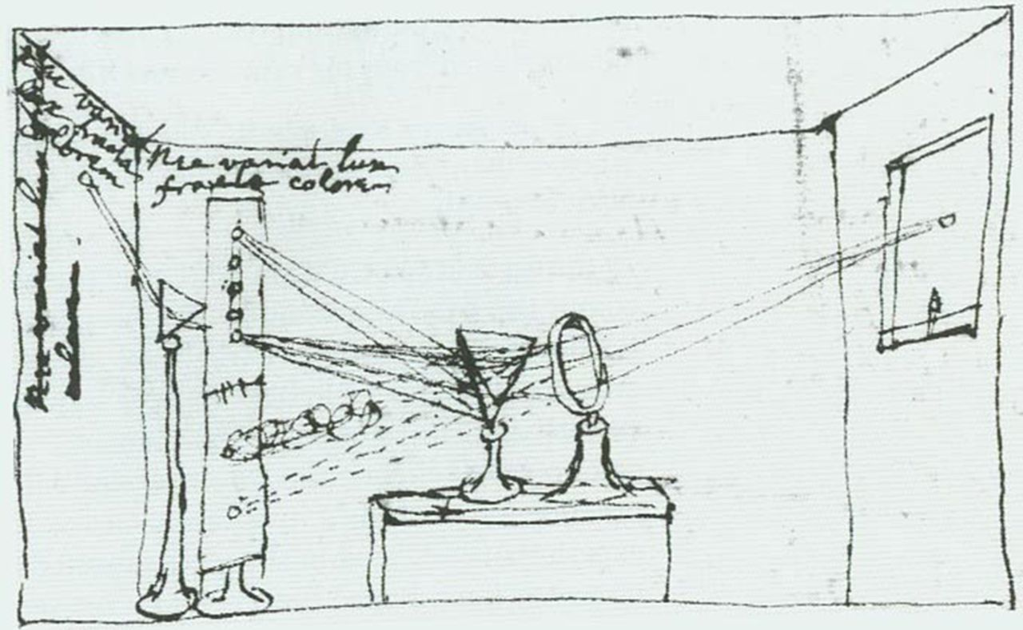
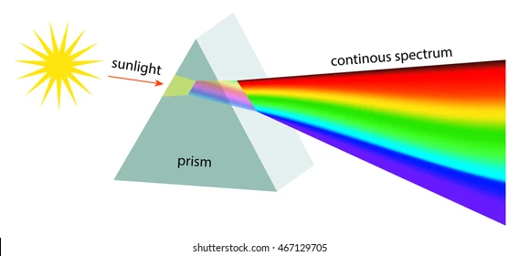
Color Physics
Isaac Newton revealed several intrinsic properties of light in experiments summarized by his drawing in Figure (Newtons original hand drawn drawing).
A pinhole of sunlight enters through the window shade, and a lens focuses the light onto a prism.
The prism then divides the white light into many different colors.
These colors are elemental: if one of the component colors is passed through a second prism, it doesn’t split into further components.
What is the meaning of elemental?

Slide 5
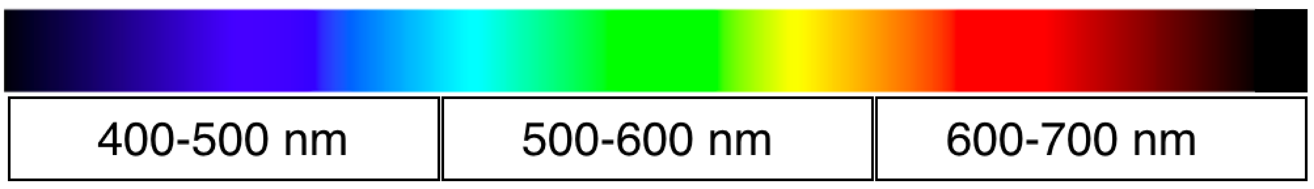
Color Appearance of Different Spectral Bands
Our understanding of light and color explains such experiments. Light is a mixture of electromagnetic waves of different wavelengths.
Sunlight has a broad distribution of light of the visible wavelengths.
At an air/glass interface, light bends in a wavelength-dependent manner, so a prism disperses the different wavelength components of sunlight into different angles, and we see different wavelengths of light as different colors.
Our eyes are sensitive to only the narrow band of that electromagnetic spectrum, the visible light, from approximately 400 nm to 700 nm, which appears blue to deep red, respectively.

Slide 6
Chromaticity or Chrominance
Chromaticity (or chrominance) in image color spaces refers to the color information of a pixel excluding brightness (luminance).
It defines "what color" something is — such as red, green, or blue — without considering how bright or dark the color is.
Color is made up of:
Luminance (brightness or intensity)
Chromaticity (hue and saturation — the actual color and its vividness (colorfulness/intensity))
Chromaticity does not include luminance (brightness or intensity).
In simple terms: Chromaticity = Color without brightness
Chrominance refers to the color information in an image (Alberto S. Aguado, 2020)

Slide 7
Chromaticity or Chrominance
Why Chromaticity matter:
Lighting Independence: Helps in identifying colors regardless of lighting conditions.
Image Compression: JPEG and video formats often reduce chromaticity resolution more than luminance, because human eye is less sensitive to color changes than to brightness changes.
Color-Based Segmentation: Chromaticity helps isolate colors more effectively, without brightness affecting detection.
Color Space | Chromaticity Components | Luminance Component
RGB | Cannot separate easily | Not separated
HSV | H (Hue), S (Saturation) | V (Value)
HSL | H (Hue), S (Saturation) | L (Lightness)
YCbCr | Cb, Cr (Chrominance) | Y (Luminance)
Lab | a, b (Chromaticity) | L (Lightness)

Slide 8
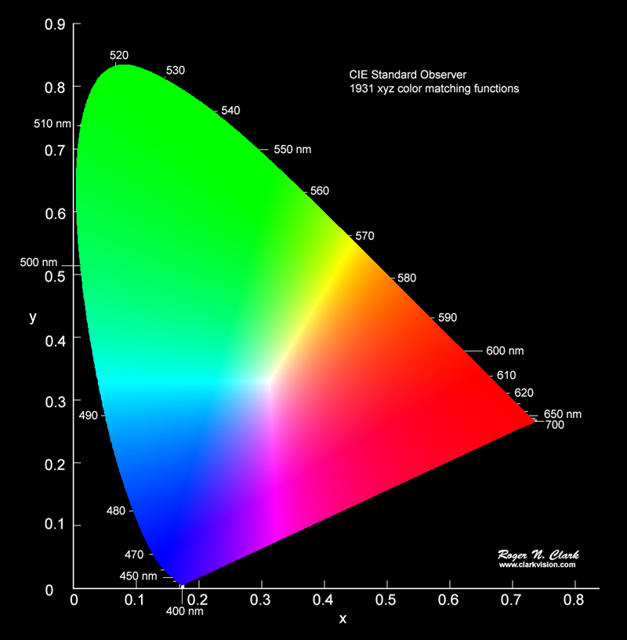
Chromaticity diagram
Developed by the CIE (International Commission on Illumination) to visually represent chromaticity.
Shows x and y coordinates of colors (hue & saturation).
The diagram forms a horseshoe shape, enclosing all perceivable colors.
White point lies in the center — mixture of all wavelengths.

Slide 9
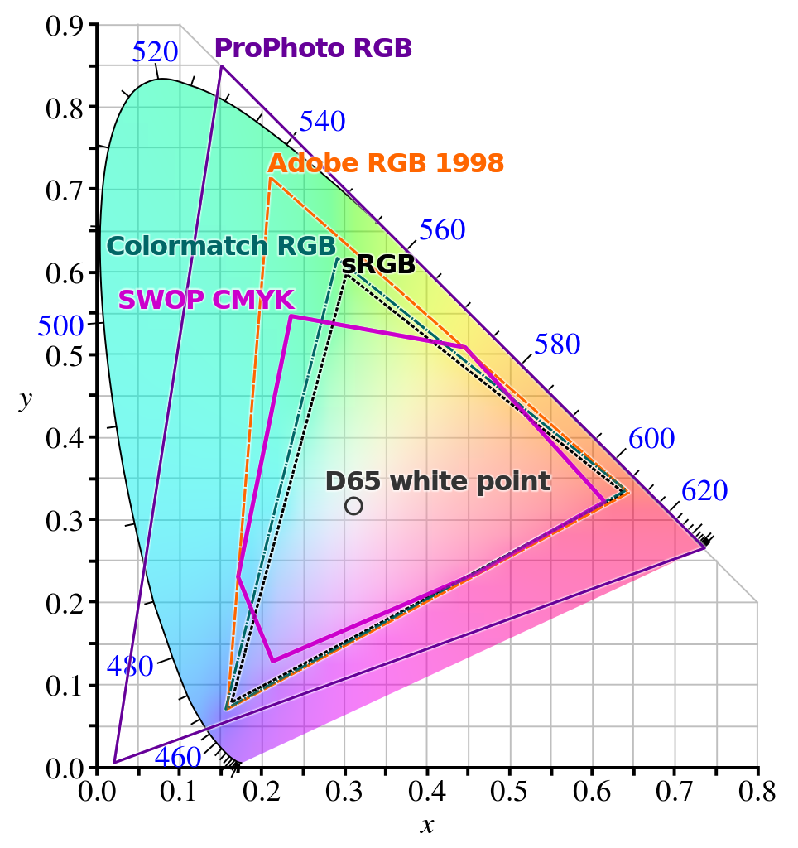
Chromaticity diagram

Slide 10
Color Spaces
We know that digital images are essentially grids of pixels, and each pixel has a value.
But how does a single number, or even a few numbers, represent the immense spectrum of colors we see?
The answer lies in color spaces.
A color space is a specific system for organizing and defining colors numerically. Think of it as a language computers use to describe color.
Different tasks and devices benefit from different ways of representing color, which is why several color spaces exist.
We'll introduce different fundamental ones commonly used in computer vision: Grayscale, RGB, , HSV and etc.

Slide 11
Grayscale color space
A grayscale image is composed of shades of gray, ranging from black (0) to white (255).
Each pixel represents only intensity, with no color.
It uses one channel instead of three (as in RGB).
Pixel Values:
0 → Black
255 → White
128 → Medium Gray
Used when color is not essential, reducing data and simplifying processing.

Slide 12
Grayscale color space
Representation: Single channel (Intensity).
Range (8-bit): 0 (Black) to 255 (White).
Use Cases:
Grayscale simplifies image data significantly.
Reducing an image from three color channels (like in RGB) to just one makes processing faster and less computationally expensive.
It's often sufficient for tasks where color isn't a primary factor, such as certain types of feature detection (like edge detection, which we'll see later) or optical character recognition (OCR).
Many complex algorithms first convert color images to grayscale.

Slide 13
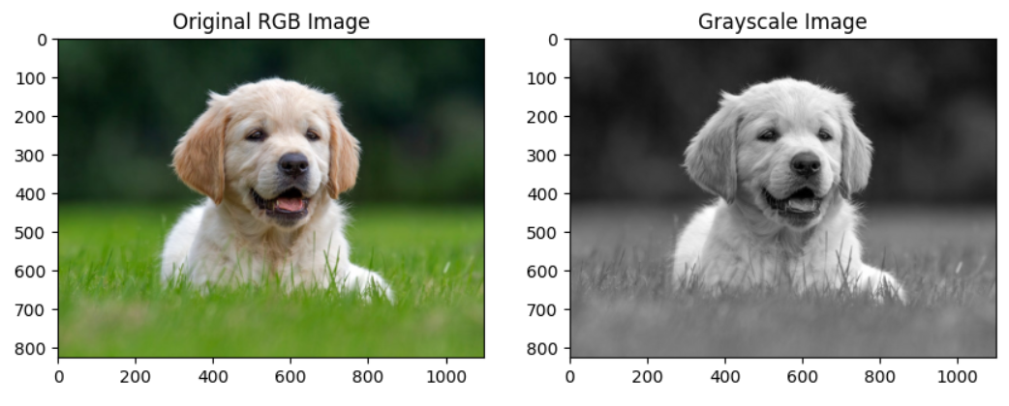
Grayscale color space
Advantages:
Simpler and faster to process.
Requires less storage and memory.
Ideal for tasks like:
Object detection, Edge detection and Facial recognition
Limitations:
No color information for distinguishing similar objects.
From a color (RGB) image, grayscale can be computed using:
Luma Formula (Weighted):
Gray = 0.2989⋅𝑅+0.5870⋅𝐺+0.1140⋅𝐵
Green is weighted more because the human eye is more sensitive to green.

Slide 14
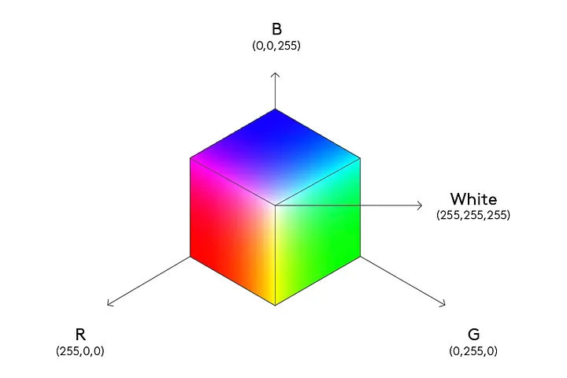
RGB color space
This is perhaps the most familiar color space, as it's widely used in digital cameras, scanners, and computer displays (like the one you're using now).
The RGB model is an additive color system. This means colors are created by mixing different intensities of Red, Green, and Blue light.
Representation: Three channels (Red, Green, Blue).
Range (8-bit per channel): Each channel (R, G, B) typically ranges from 0 to 255.

Slide 15
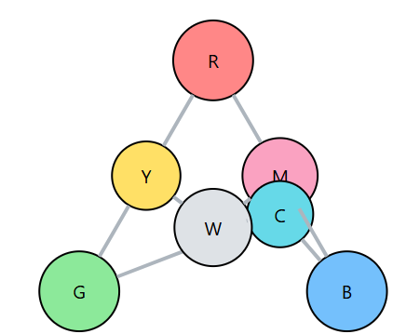
RGB color space
Mixing Colors:
(0, 0, 0) represents Black (no light).
(255, 255, 255) represents White (maximum intensity of all three).
(255, 0, 0) represents pure Red.
(0, 255, 0) represents pure Green.
(0, 0, 255) represents pure Blue.
Mixing these primary colors creates secondary colors like Yellow (255, 255, 0), Cyan (0, 255, 255), and Magenta (255, 0, 255).
OpenCV, by default, reads images in the BGR (Blue, Green, Red) color space. The difference lies in the order of the channels.
Historically, OpenCV adopted BGR as its default because of how some camera manufacturers and software libraries stored color information.

Slide 16
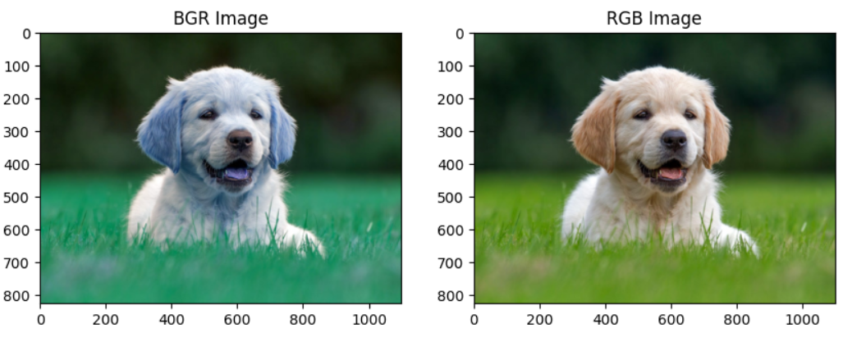
RGB color space
Limitations:
Not perceptually uniform — equal changes in values don’t correspond to equal perceived changes in color.
Not ideal for:
Color-based segmentation
Color comparison
Object detection in varying lighting
Often converted to other color spaces like HSV, Lab, or YCbCr for advanced tasks.

Slide 17
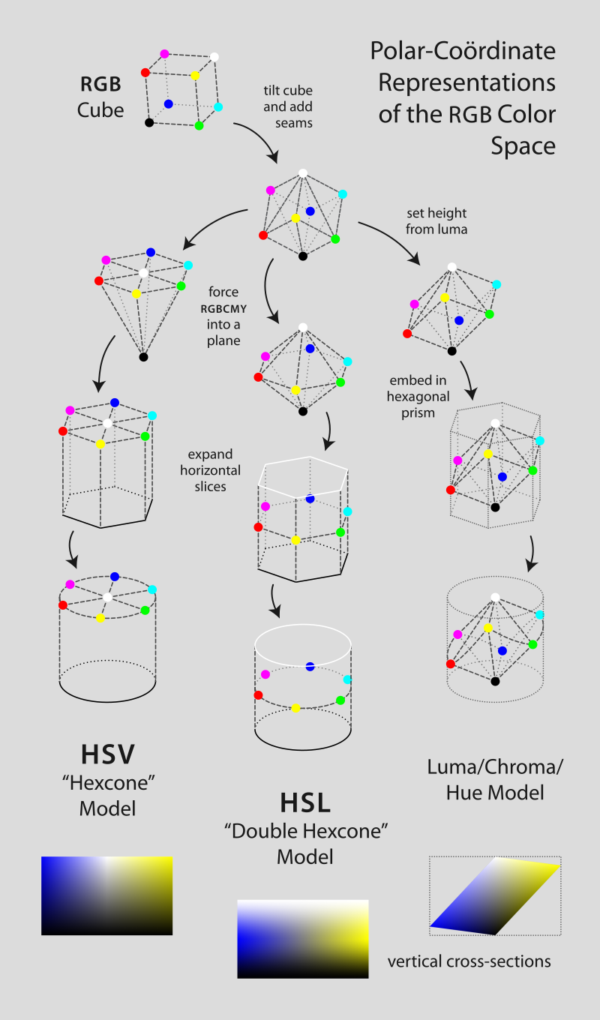
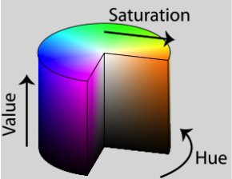
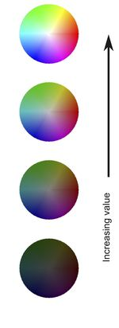
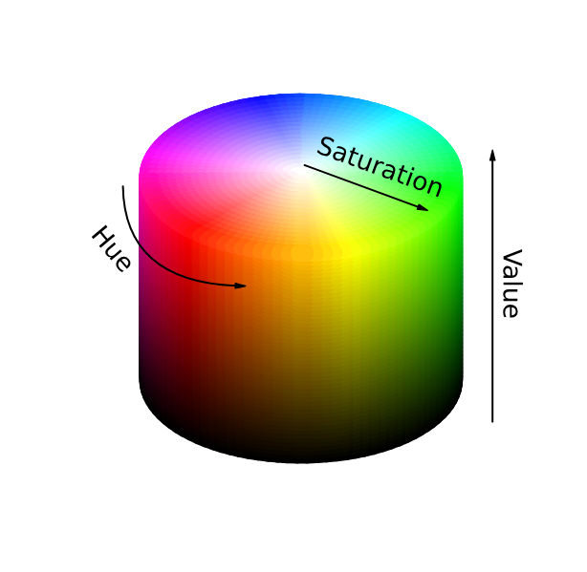
HSV color space
The HSV color space represents color in a way that is often considered more intuitive for humans because it separates color information (what color it is) from its intensity or brightness.
It's often visualized as a cylinder.

Slide 18
HSV color space
Hue (H):
This represents the pure color itself.
Think of it as the position on a color wheel.
It's typically represented as an angle from 0 to 360 degrees, although libraries like OpenCV often map this range to 0-179 (to fit within an 8-bit value) or 0-255.
Red might be around 0 degrees, Green around 120, and Blue around 240.
Saturation (S):
This represents the "purity" or "intensity" of the color.
A saturation of 0 means the color is grayscale (a shade of gray, black, or white), while maximum saturation represents the purest possible version of the color defined by the Hue.
It's usually represented as a percentage (0-100%) or a range (e.g., 0-255).
A faded color has low saturation; a vibrant color has high saturation.
HSV Color picker: https://www.w3schools.com/colors/colors_hsl.asp

Slide 19
HSV color space
Value (V):
This represents the brightness or lightness of the color.
A value of 0 is always black, regardless of Hue or Saturation.
As the value increases, the color becomes brighter, up to its maximum intensity.
It's also typically represented as a percentage (0-100%) or a range (e.g., 0-255).
HSV separates color information from brightness, making it useful for color-based segmentation and visual adjustments.
Non-Perceptual Uniformity:
Equal changes in HSV values do not result in equal perceived color differences.
Poor for tasks requiring accurate color difference measurement.
Avoid HSV when:
You need precise color comparison or color distance measurement→ Use CIELAB (Lab) instead
Working with shadowed or low-light images
Processing images with shiny, reflective, or highly saturated (mean pure color with less mixture) regions

Slide 20
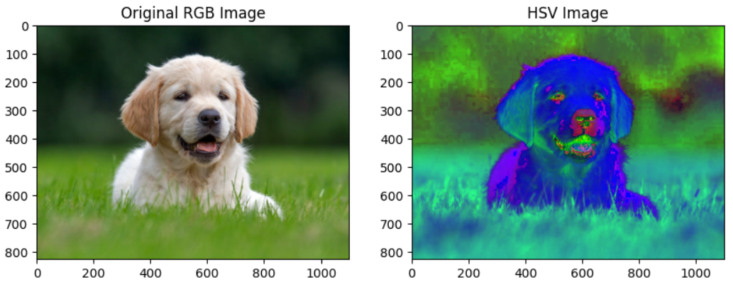
HSV color space
HSV Color picker: https://www.w3schools.com/colors/colors_hsl.asp

Slide 21
Lab color space
A Perceptually Uniform Color Space for Vision Applications.
Lab stands for L* (Lightness), a*, b* Designed to approximate human color perception
Perceptually uniform: equal changes in value mean equal changes in perceived color
Based on CIELAB standard by CIE.
L* Lightness (0–100), similar to grayscale brightness
a* Green (–) to Red (+) axis
b* Blue (–) to Yellow (+) axis

Slide 22
Lab color space
Theoretical CIELAB Ranges (Standard Definition)
Channel | Range | Meaning
L* | 0 to 100 | Lightness (0 = black, 100 = white)
a* | –128 to +127 | Green (–) to Red (+)
b* | –128 to +127 | Blue (–) to Yellow (+)
OpenCV Lab Ranges (8-bit Image Conversion)
When you convert an image from BGR to Lab using OpenCV and work with uint8 images (8-bit), OpenCV scales the
values to fit in the 0–255 range:
Channel | OpenCV Range (8-bit) | Notes
L* | 0 to 255 | Scaled from 0–100 (multiply by 2.55)
a* | 0 to 255 | Original range –128 to 127 shifted by +128
b* | 0 to 255 | Original range –128 to 127 shifted by +128

Slide 23
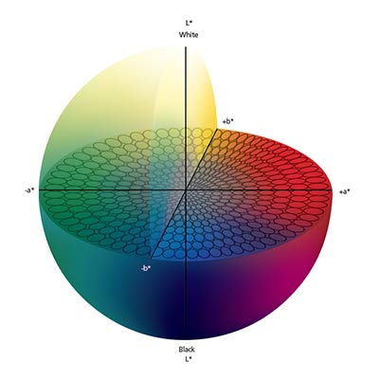
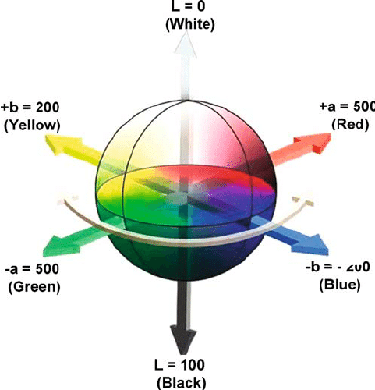
Lab color space

Slide 24
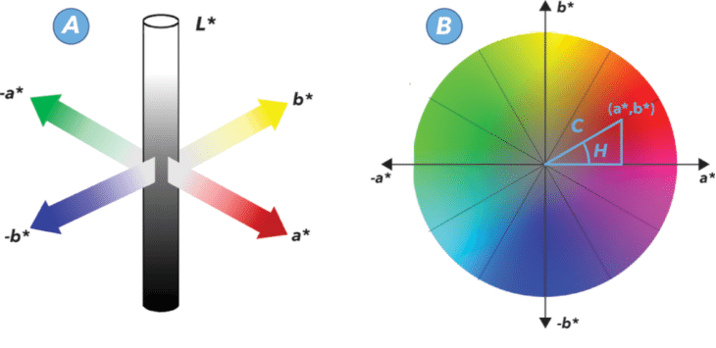
Lab color space

Slide 25
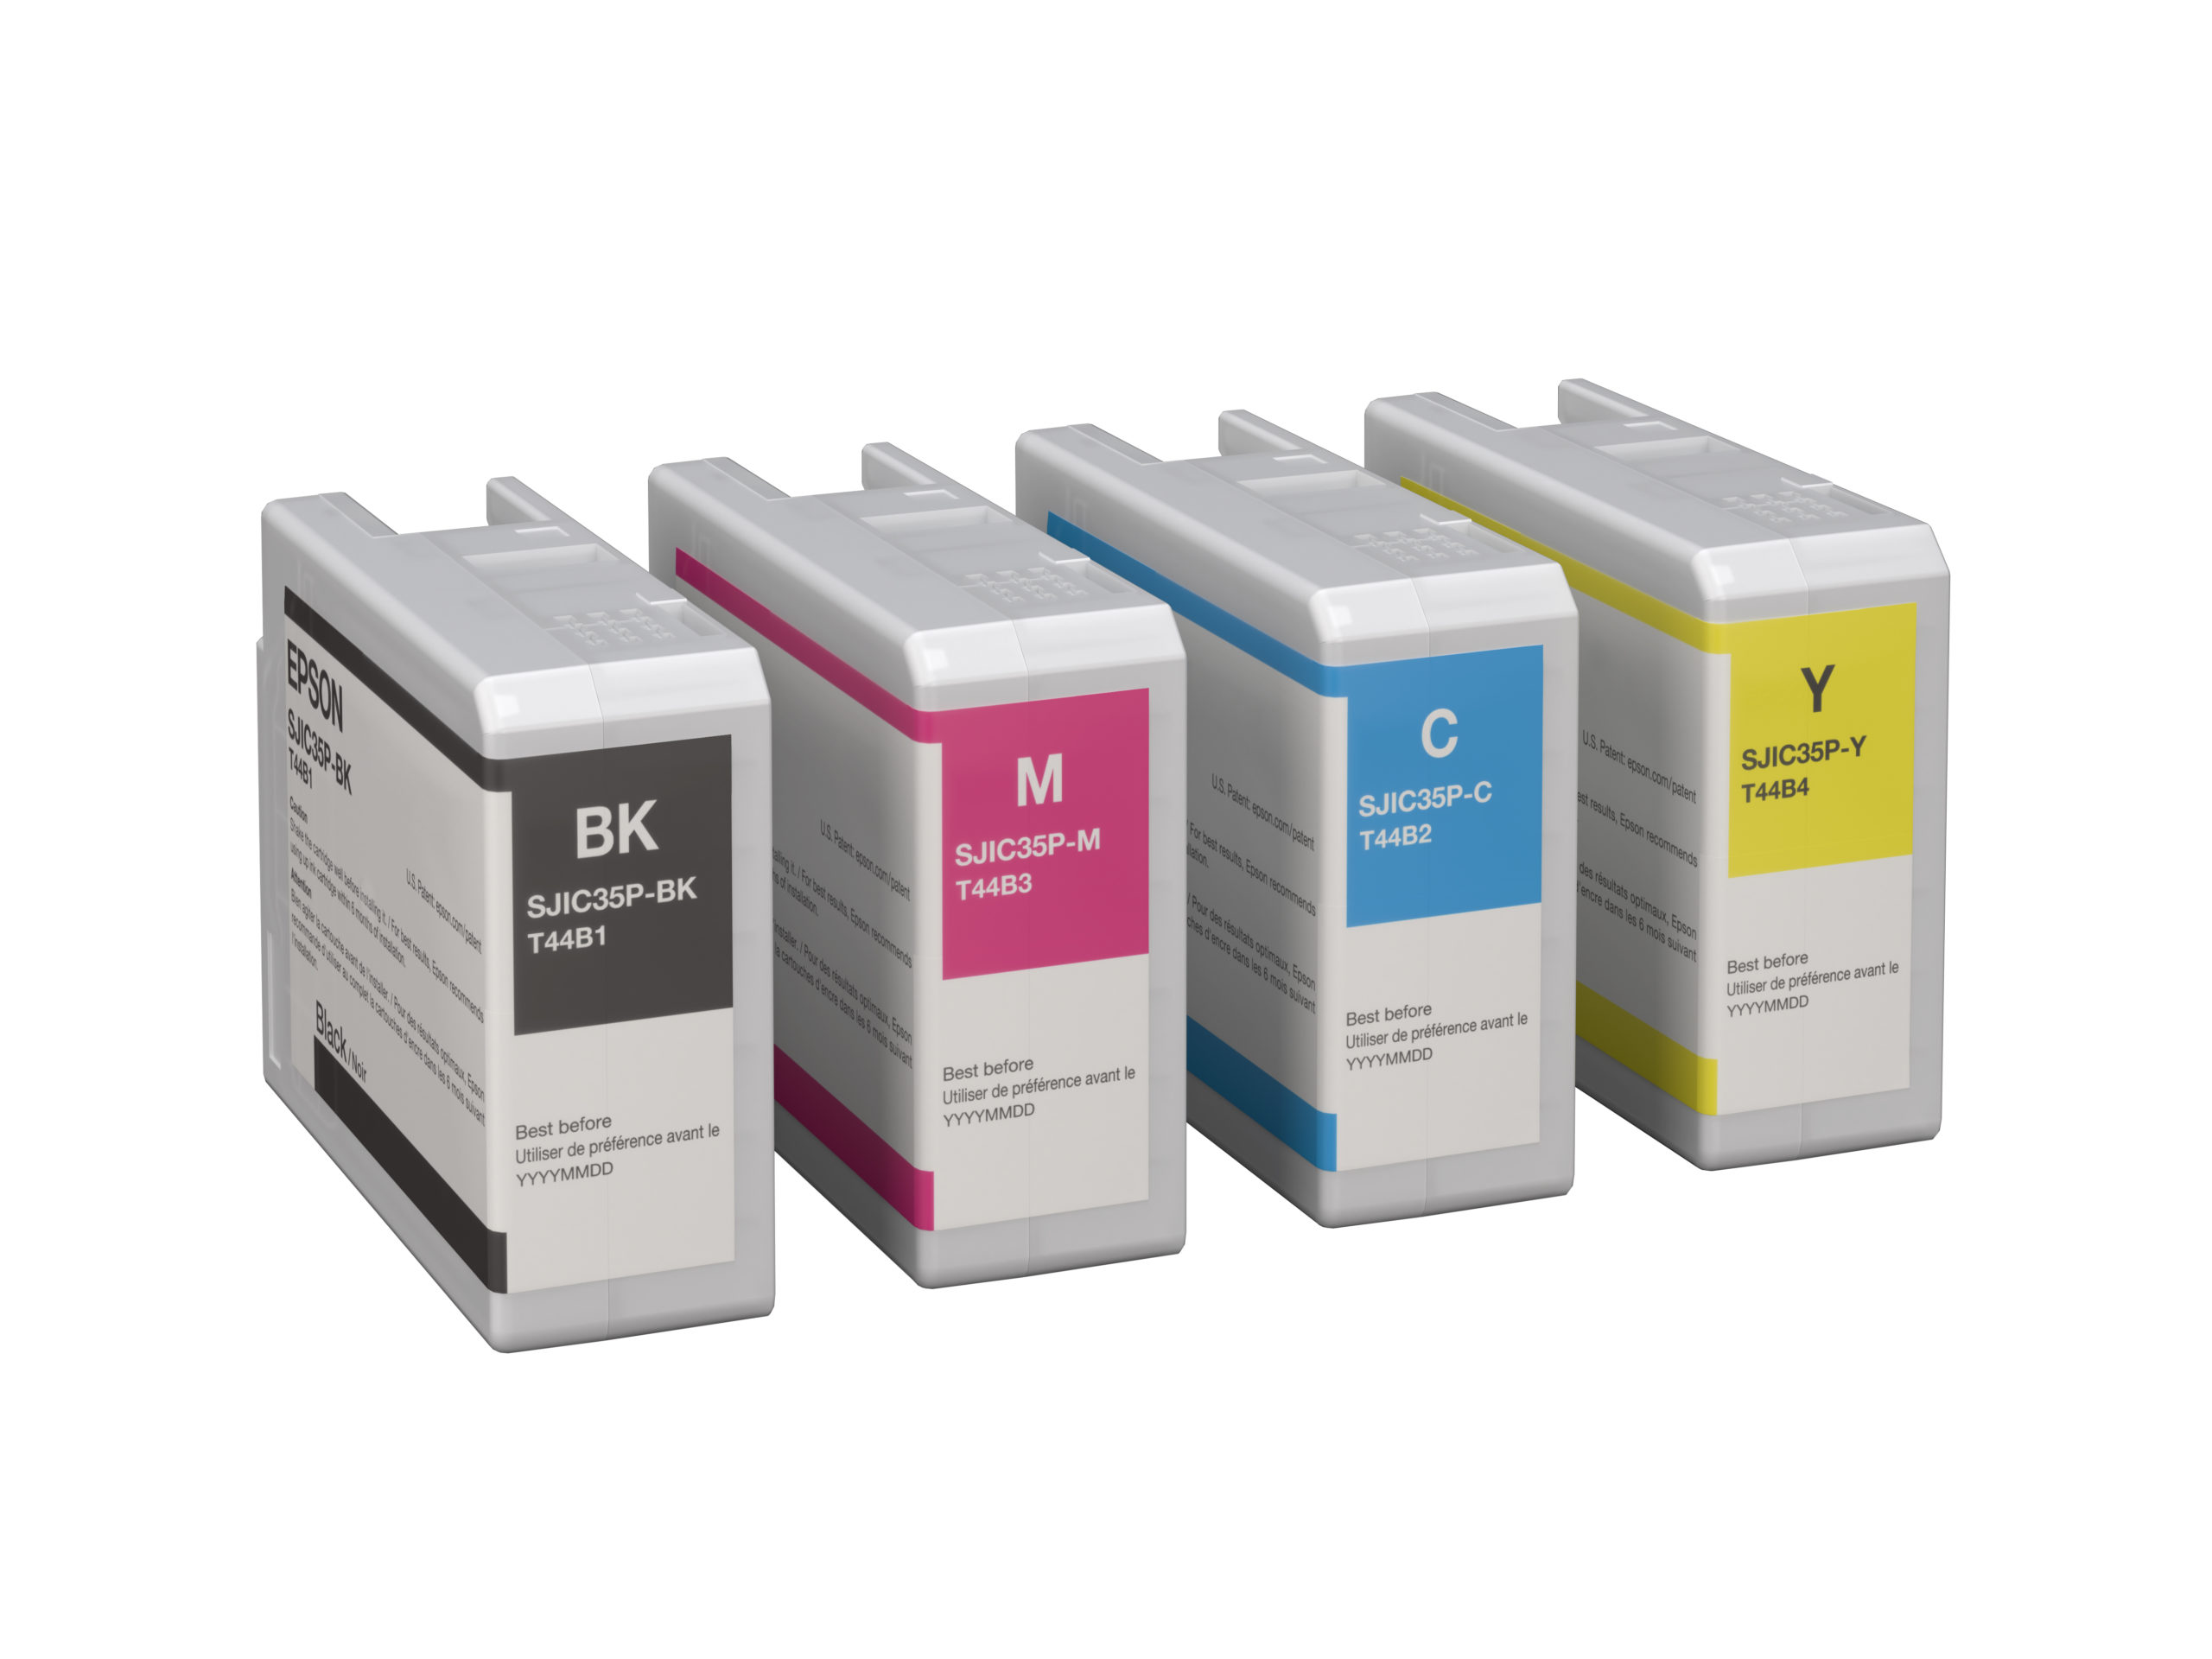
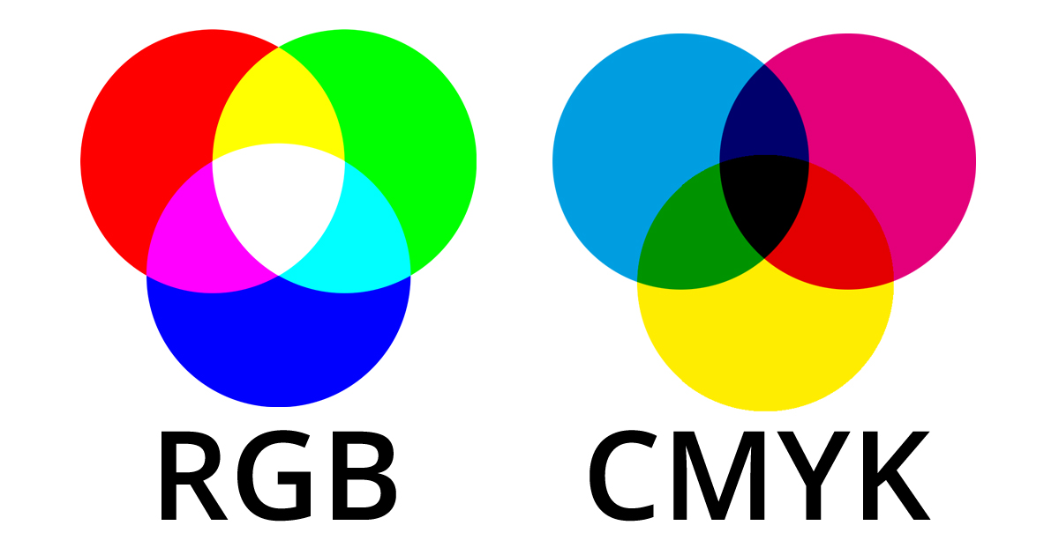
CMYK color space
Color Representation for Printing and Design
CMYK stands for:
Cyan
Magenta
Yellow
Key (Black)
A subtractive color model used in color printing
Colors are created by removing light (absorption of wavelengths)
Feature | CMYK | RGB
Type | Subtractive (ink-based) | Additive (light-based)
Used in | Printing | Displays (monitors, TVs)
Color mixing | Inks absorb light | Light is added to mix
Black creation | K channel | Absence of colors

Slide 26
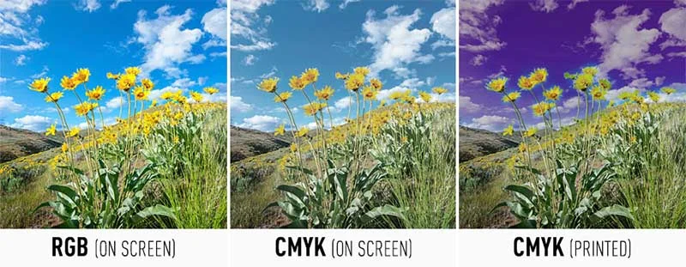
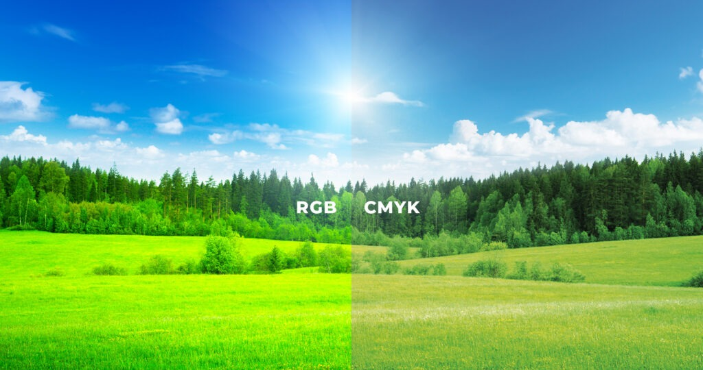
CMYK color space

Slide 27
Subtractive Color spaces
A subtractive color space is a color model where colors are created by removing (subtracting) wavelengths of light from white light using pigments, dyes, or inks.
In subtractive color mixing:
You start with white light (e.g., paper under daylight).
Pigments or inks absorb (subtract) certain wavelengths.
The remaining reflected light defines the perceived color.
Cyan (C) absorbs red
Magenta (M) absorbs green
Yellow (Y) absorbs blue
Mixing all three ideally removes all light → black
Real printers add black (K) ink for deeper blacks and better contrast

Slide 28
Subtractive Color spaces
Feature | Additive (e.g., RGB) | Subtractive (e.g., CMYK)
Starting color | Black (no light) | White (all light)
Mixing adds | Light | Pigments
Combined primary colors | White | Black (in theory)
Common use | Screens, digital displays | Printing, painting
Imagine printing a green leaf:
You start with white paper.
The printer uses cyan and yellow inks.
Cyan absorbs red, yellow absorbs blue → only green is reflected to your eyes.
Subtractive color spaces work by absorbing light, not emitting it.
They're used in printing, painting, and any medium involving pigments.
CMY and CMYK are the most common subtractive color models.

Slide 29

Additive Color spaces
An additive color space is a color model where colors are formed by adding light of different colors together.
It’s based on the principle that the more light you add, the brighter the resulting color becomes.
Primary Colors in Additive Model:
Red
Green
Blue
Additive color spaces use light to create color.
As more colors of light are added, the result gets closer to white.
The most common example is the RGB color model, used in all digital displays.
Note: RGB are add then white is result, whereas; in CMYK the
results is black (means absence of all light wavelengths)

Slide 30
Comparative table of major color spaces
Color Space | Type | Components | Human-Intuitive? | Perceptually Uniform? | Device Dependent? | Common Use Cases
RGB | Additive | R, G, B | ❌ No | ❌ No | ✅ Yes | Screens, digital cameras, image editing
CMY | Subtractive | C, M, Y | ❌ No | ❌ No | ✅ Yes | Theoretical subtractive model
CMYK | Subtractive | C, M, Y, K | ❌ No | ❌ No | ✅ Yes | Inkjet printing, publishing
HSV | Derived from RGB | H, S, V | ✅ Yes | ❌ No | ✅ Yes | Color selection tools, user interfaces
HSL | Derived from RGB | H, S, L | ✅ Yes | ❌ No | ✅ Yes | Graphics design, artistic tools
Lab (CIELAB) | Perceptual | L, a, b | ✅ Yes | ✅ Yes | ❌ No (device-independent) | Image correction, perceptual comparisons
YCbCr | Derived from RGB | Y, Cb, Cr | ❌ No | ❌ No | ✅ Yes | Video compression (JPEG, MPEG, H.264)

Slide 31
Assignment # 02
Deadline: 02 week after this slides presented.
Use the provided code with following tasks:
Task 01: For RGB, BGR, HSV, CMYK, YuYb, Lab, show each of the channel from these color spaces separately.
Task 02: For the above color spaces, remove the brightness channel and show the image without brightness.
Marks: 01
No extension of deadline!
Late submissions will get zero marks.

Slide 32
Image filtering
Image filtering is the process of modifying or enhancing an image by manipulating pixel values based on a specific operation or mathematical rule.
It typically involves applying a filter (or kernel) to an image to achieve a desired effect.
Filter = small matrix (kernel) applied to an image
Used to emphasize or suppress certain features, e.g., Smoothing, sharpening, edge detection, denoising

Slide 33
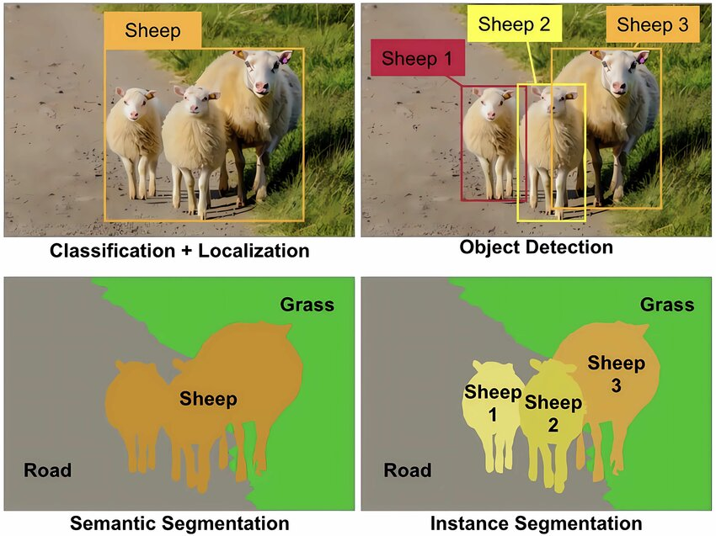
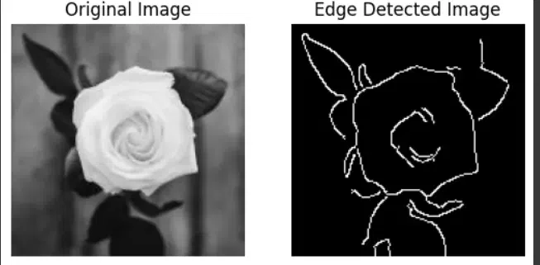
Image filtering
Purpose & Significance:
Pre-processing: Prepares images for further analysis (e.g., segmentation, object detection)
Noise Reduction: Improves image quality by removing unwanted variations
Feature Enhancement: Highlights specific patterns or structures (e.g., edges)
Compression: Helps in reducing image data for efficient storage

Slide 34
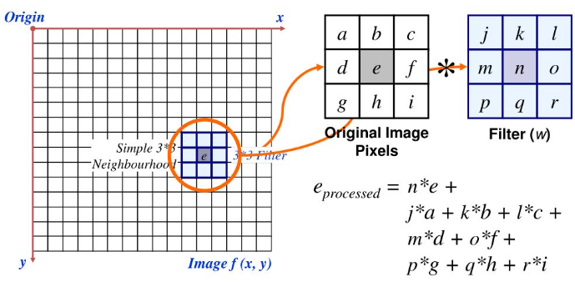
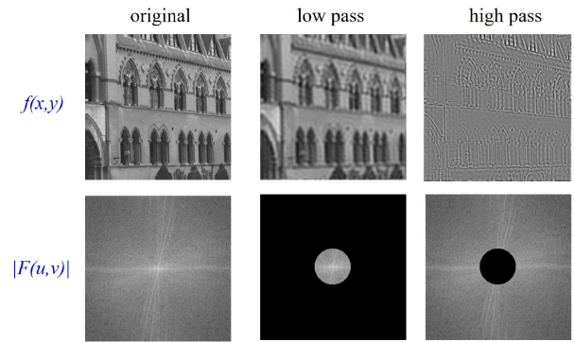
Classification of Image Filtering
Filters can be classified by:
Domain: How and where the filter is applied
Operation Type: The mathematical nature of the filter
Two Major Domains:
Spatial Domain Filtering
Operate directly on pixel values
Use kernels or neighborhood operations
Frequency Domain Filtering
Operate on frequency representation of the image (Fourier transform)
Modify frequency components

Slide 35
Classification of Image Filtering
Filters Based on Operation Type
Linear Filters
Output pixel is a linear combination of input pixels (e.g. the output pixel is a weighted sum (a linear combination) of the input pixels in the neighborhood.)
Represented by convolution with a kernel
Examples: Box filter, Gaussian filter, Sobel filter, Laplacian
Non-linear Filters
Output pixel depends non-linearly on input pixels
In non-linear filters, the output pixel is computed using a non-linear function of the neighborhood pixels. That means: It cannot be expressed as a simple sum of weighted pixel values.
The process involves operations like min, max, median, conditional checks, etc.
Used for noise removal, edge preservation, morphological operations
Examples: Median filter, Bilateral filter, Morphological operations

Slide 36
Frequency and spatial domain in images
Images can be represented two domains:
Spatial and Frequency.
Spatial domain: image represented by pixel intensities.
Frequency domain: image represented by sinusoidal components (variations in brightness).
Transform from spatial to frequency domain is done using the Fourier Transform.
Why we used frequency domain
Enables better analysis of texture, patterns, and edges.
Useful for: Image filtering (e.g., denoising, sharpening).
Image compression (e.g., JPEG).
Feature extraction and matching.

Slide 37
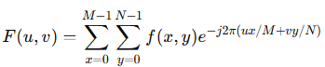
Fourier Transform
Converts image from spatial domain to frequency domain.
1D: For signals;
2D: For images.
Discrete Fourier Transform (DFT):
Fast Fourier Transform (FFT): Efficient computation of DFT.
Frequency domain image:
Center = low frequencies (smooth areas).
Edges = high frequencies (edges, noise).
Often shown with log scale for better visualization.
Can use fftshift to move zero-frequency component to center.
Symbol | Description
f(x,y) | The intensity value of the pixel at spatial coordinates (x,y)(x, y). This is your input image.
F(u,v) | The complex frequency component at frequency coordinates (u,v)(u, v). This is the output of the transform — it represents how much of a certain frequency is present in the image.
M | Width of the image (number of columns/pixels along x-axis).
N | Height of the image (number of rows/pixels along y-axis).
x, y | Spatial coordinates (position in the image).
u,v | Frequency coordinates (horizontal and vertical frequency indices).
j | Imaginary unit: j=−1j = \sqrt{-1}.
e−j2π(...) | The complex exponential, representing a sinusoidal wave (a combination of sine and cosine). It acts as a basis function.
Notes:
The Fourier Series is a mathematical tool that allows us to represent a periodic function as a sum of sine and cosine functions (or complex exponentials).
Intuition: Any periodic signal (like a square wave, sawtooth wave, etc.) can be thought of as a combination of simple sine and cosine waves of different frequencies, amplitudes, and phases. The Fourier Series tells us how much of each frequency is present in the signal.

Slide 38
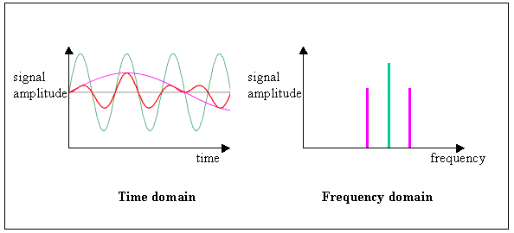
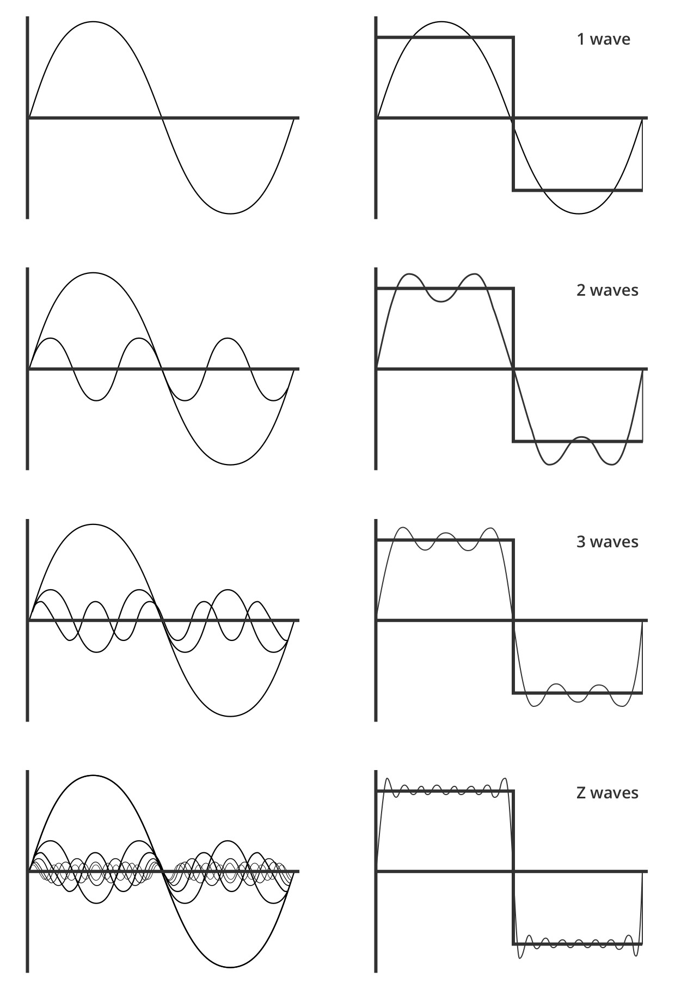
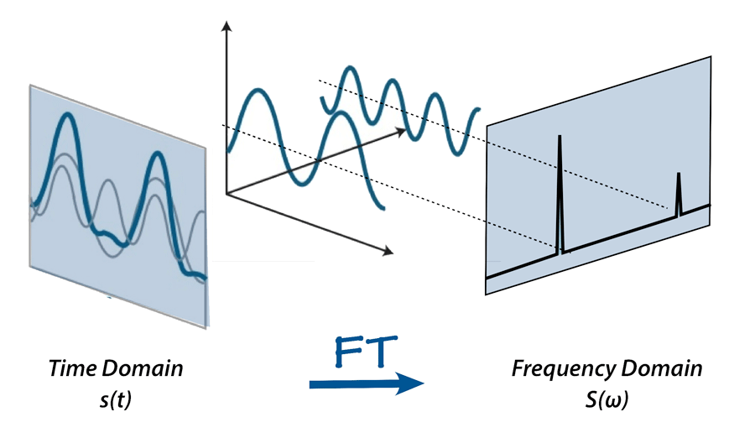
Fourier Transform

Slide 39
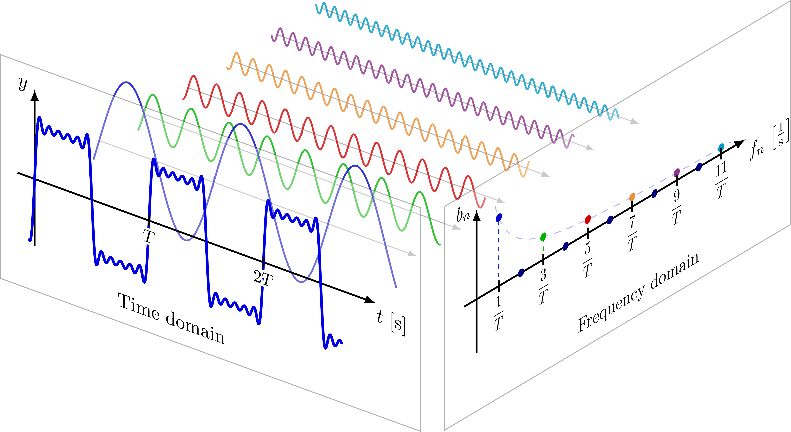
Fourier Transform

Slide 40
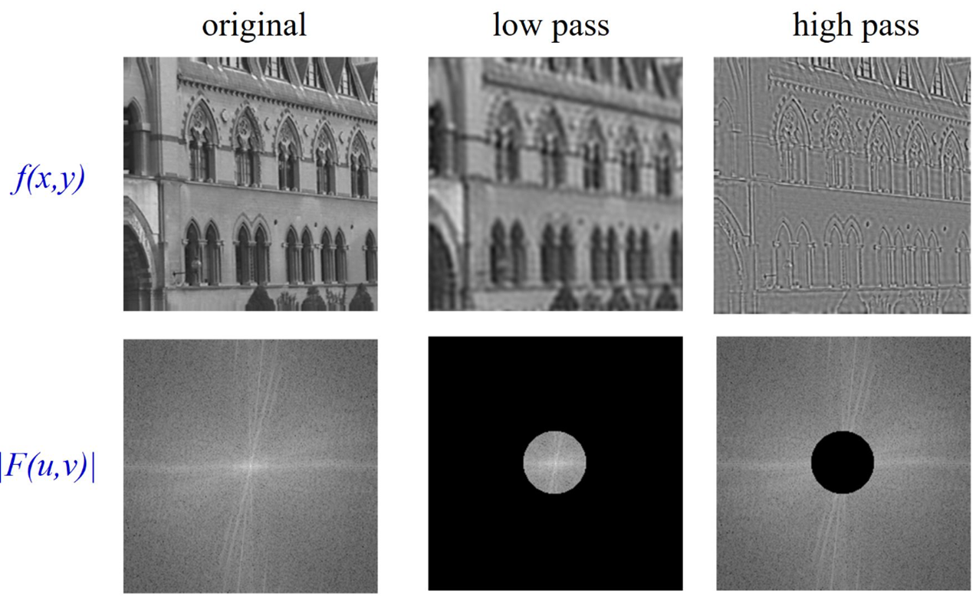
Frequency domain filtering
What is Frequency Domain Filtering?
Instead of modifying pixel values directly (spatial domain), we:
Transform the image to the frequency domain
Apply a filter mask (modify frequency components)
Inverse transform back to spatial domain
Why use it?
Efficient for large filters
Enables global filtering (e.g., low-pass, high-pass)
Precise control over specific frequency components

Slide 41
Types of Frequency domain filtering
Low pass filter
Blocks high frequencies (edges, noise)
Allows low frequencies (smooth areas)
Used for blurring or denoising
For visualizing low pass filter we do:
Bright center (low frequencies passed)
Dark edges (high frequencies blocked)
High pass filter
Removes smooth regions
Enhances high frequencies (edges, noise)
Used for sharpening or edge detection
Visualizing a High-Pass Filter
Black center (low frequencies blocked)
Bright edges (high frequencies passed)
Band pass filter
Allows mid-range frequencies
Blocks low (smooth) and high (sharp) details
Used for texture analysis, feature extraction
Visualizing a Band-Pass Filter
Two concentric circles: white ring in middle

Slide 42
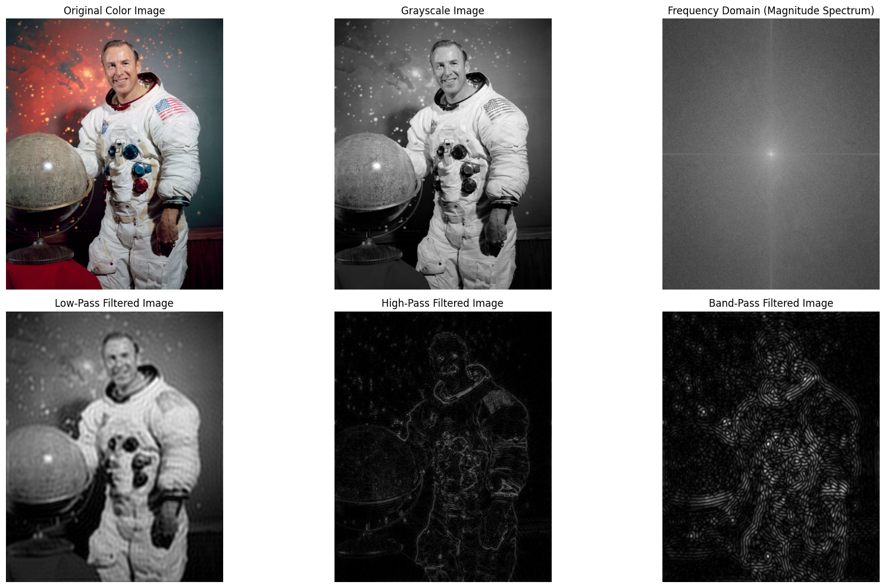
Types of Frequency domain filtering

Slide 43
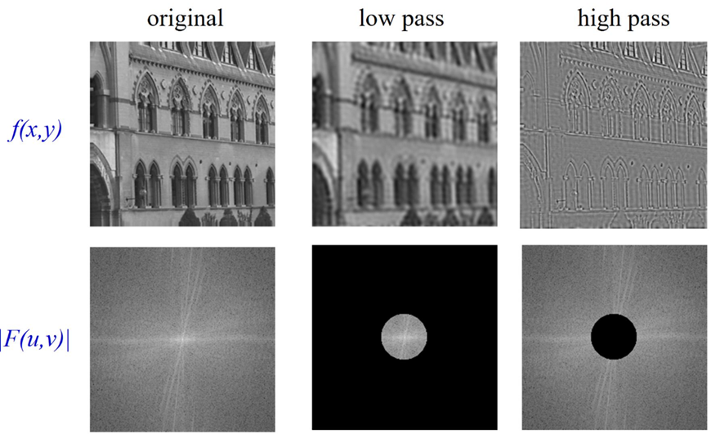
Types of Frequency domain filtering
Filter Type | Purpose | Frequency Range Affected
Low-Pass | Smoothing | Keeps low frequencies
High-Pass | Edge detection | Keeps high frequencies
Band-Pass | Texture analysis | Keeps mid-range frequencies

Slide 44
Linear filtering
Applies a kernel (filter mask) to every pixel using a weighted sum.
Example (3×3 kernel):
Produces a new image with local changes (blur, sharpen, etc.)
Types of linear filters
Box filter
Gaussian filter
Laplacian filter
Linear Filters
A linear filter modifies an image based on a weighted sum of neighboring pixels.
It’s called linear because the operation follows linearity:
Additivity:
Output of (A + B) = Output of A + Output of B
Homogeneity:
Output of (kA) = k × Output of A
Used for: smoothing, sharpening, edge detection, etc.
[1 1 1] Image patch: New value = sum(weights × pixels)
[1 1 1] × [p1 p2 p3] → Output pixel p5 at center
[1 1 1] [p4 p5 p6]
[p7 p8 p9]

Slide 45
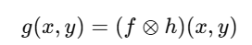
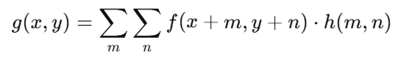
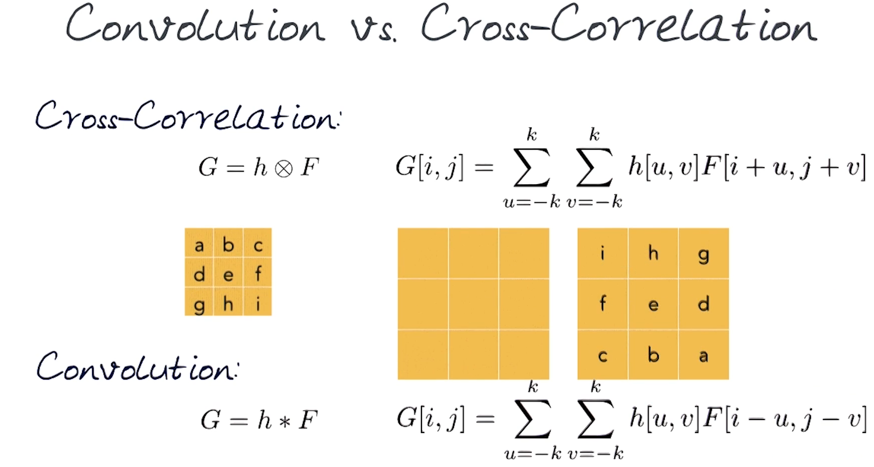
Linear filtering (Convolution & Cross-correlation)
Correlation is similar to convolution but does not flip the kernel.
It measures similarity between a kernel and the local image patch.
Denoted as:
𝑓(𝑥,𝑦): Input image
ℎ(𝑚,𝑛): Filter (kernel)
𝑔(𝑥,𝑦): Output image
Steps:
Flip the kernel horizontally and vertically
Slide it over the image
At each position, compute the sum of element-wise multiplication
Replace the center pixel with this value
Intuition:
Acts like a weighted neighborhood calculation.
Picks up local features like edges, texture, or smooth areas.

Slide 46
Linear filtering
Common linear filters
Smoothing filters (Low pass filters)
Box
Gaussian
Average
Sharpening filters (High pass filters)
Laplacian
High boost
Gradient based
Edge detection filters
Sobel
Prewitt
Scharr
Directional filters
Gabor
Directional derivative

Slide 47
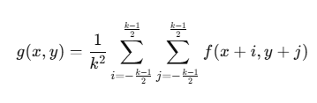
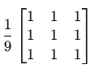
Linear filtering (Smoothing)
Box (averaging) filter
One of the simplest linear filters as It replaces each pixel value with the average of the pixel values in its local neighborhood.
This has the effect of smoothing the image by reducing intensity variations (noise or texture).
The filter kernel is a matrix where all elements have the same value, summing up to 1.
Mathematically:
where 𝑘 is the kernel size.
Example: 3x3 kernel
This kernel takes the average of the 9 pixels in the 3×3 window

Slide 48
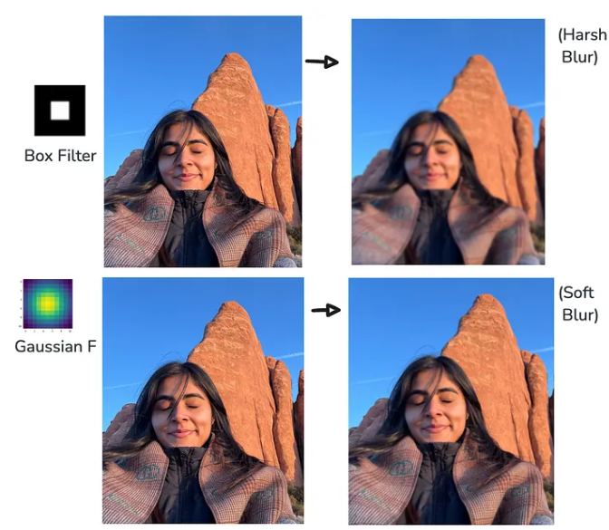
Linear filtering (Gaussian)
Gaussian filter
Gaussian Filter is a very special filter among Linear Filters for many reasons.
First, they are vastly used for Image Transformation, like turning an image into a smoother image which we can sometimes refer to as Smooth Noise Reduction. (See example)
Second, Gaussian Filters play a vital role in Image Preprocessing like Edge Detection, Feature Extraction, Image Sharpening, etc…
Unlike a simple box filter, that assigns equal weights to all kernel, Gaussian Filter adds soft blur to images which is more natural whereas, box filter adds harsh blur (uniform).

Slide 49
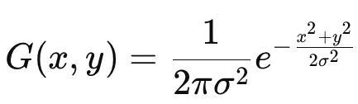
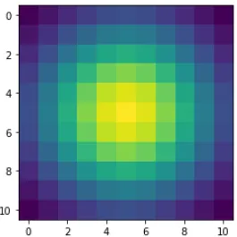
Linear filtering (Gaussian)
Gaussian filter working
Gaussian filter uses Gaussian distribution for assign weights to its kernel.
Like any other filter, the Gaussian filter applies weighted average to neighboring pixels in the image except that here the kernel weights are based on Gaussian distribution.
The Gaussian Function gives higher weight to the pixels closer to the centre of the kernel because of the exponential decay. This helps to preserve the edges compared to Uniform averaging like in a box filter.

Slide 50
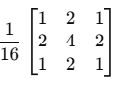
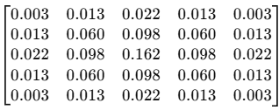
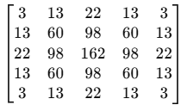
Linear filtering (Gaussian)
Gaussian filter working

Slide 51
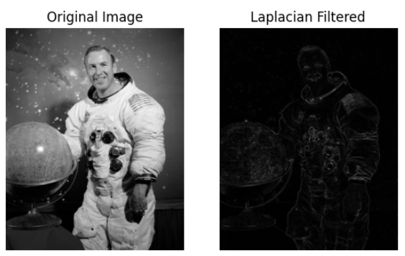
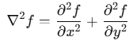
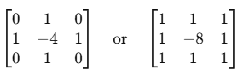
Linear filtering (Sharpening)
Sharpening filters
Enhance edges and fine details by emphasizing high-frequency components.
Use cases: edge enhancement, detail recovery, feature extraction
Laplacian filter
Second-order derivative operator
The Laplacian filter is called a 2nd order derivative operator because it computes the second derivatives of the image intensity function in both the horizontal (x) and vertical (y) directions.
Detects regions of rapid intensity change
It detects edges regardless of direction
Simple kernel example:
How?

Slide 52


Slide 53
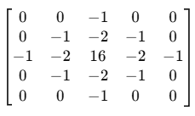
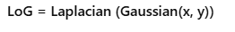
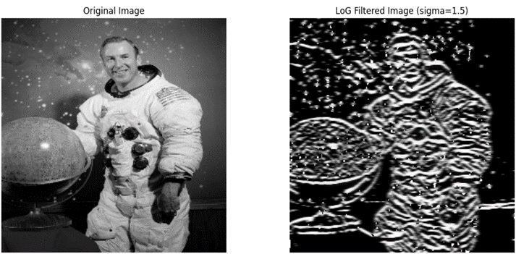

Linear filtering (Sharpening)
LoG (Laplacian of Gaussian) filter
The Laplacian of Gaussian (LoG) filter is a widely used operator in image processing and computer vision for edge detection that combines smoothing and second-derivative edge detection.
Gaussian smoothing: First, the image is smoothed with a Gaussian filter to reduce noise.
Laplacian operator: Then, the Laplacian (second derivative) is applied to detect edges.
Mathematically, the LoG filter is the Laplacian applied to a Gaussian function:
5x5 LoG kernel

Slide 54
Linear filtering (Sharpening)
Step-by-Step Procedure for edge detection
Step 1: Convert to Grayscale (if input is color)
Work with a single intensity channel:
Step 2: Smooth the Image (Optional but Recommended)
Apply a Gaussian blur to reduce noise, as derivatives amplify noise:
Step 3: Apply Laplacian Convolution
Convolve the smoothed image with a Laplacian kernel L:
This yields the Laplacian response — positive/negative values around edges.
Step 4: Zero-Crossing Detection (for edge localization)
Edges correspond to points where the Laplacian changes sign (zero-crossings). Algorithm:
Scan L(x,y) for pixels where:
One neighbor has opposite sign and
The difference in values exceeds a threshold.
Mark those pixel locations as edges.
Step 5: Output Binary Edge Map
Set edge pixels to 1 (white), non-edges to 0 (black).

Slide 55
Linear filtering (Sharpening)
LoG (Laplacian of Gaussian) filter
Filter Type | Linear? | Sharpening? | Notes
Laplacian | Yes | Yes | Detects edges, enhances details
Gaussian | Yes | No (smoothing only) | Blurs image
LoG | Yes | Yes (edge detection + sharpening) | Smoothed edge detection

Slide 56




Linear filtering (Sharpening)
High Boost filter
Enhances high-frequency details
Used to emphasize edges and fine details in images
Enhances an image by adding a scaled version of the high-frequency components back to the original

Slide 57

Linear filtering (Sharpening)

Slide 58

Linear filtering (Edge detection)
Edge detection filters
Detects significant intensity changes in an image.
Highlights object boundaries, shapes, textures.
Essential for tasks like segmentation, recognition, and feature extraction.
Edges = High gradient magnitudes
Compute gradient of image intensity:

Slide 59


Linear filtering (Edge detection)
Sobel filter
Combines Gaussian smoothing + differentiation
More robust to noise than simple derivatives
Highlights vertical and horizontal edges
Sobel Kernels:
Horizontal (X-direction):
Vertical (Y-direction):
[[-1, 0, 1],
[-2, 0, 2],
[-1, 0, 1]]
[[-1, -2, -1],
[ 0, 0, 0],
[ 1, 2, 1]]

Slide 60

Linear filtering (Edge detection)
Prewitt filter
Similar to Sobel, but simpler kernel
No Gaussian smoothing component
Lightly more sensitive to noise
Prewitt Kernels:
Horizontal (X-direction):
Vertical (Y-direction):
[[-1, 0, 1],
[-1, 0, 1],
[-1, 0, 1]]
[[-1, 0, 1],
[-2, 0, 2],
[-1, 0, 1]]
[[-1, -1, -1],
[ 0, 0, 0],
[ 1, 1, 1]]
[[-1, -2, -1],
[ 0, 0, 0],
[ 1, 2, 1]]

Slide 61

Linear filtering (Edge detection)
Feature | Sobel | Prewitt
Kernel | Weighted | Uniform (It gives equal weight to kernel either in row or column)
Noise resistance | Better | Weaker
Accuracy | Higher | Lower
Computation | Slightly more | Slightly less

Slide 62

Linear filtering (Directional)
Directional filters
Filters designed to respond to specific orientations or directions
Useful for detecting edges, textures, and patterns aligned at certain angles
Key in texture analysis, feature extraction, and image segmentation
Gabor filter
Gabor filter = Gaussian-modulated sinusoid
Sensitive to frequency and orientation
Used to model human visual system’s response to textures and edges
A Gabor filter can be viewed as a sinusoidal signal of particular frequency and orientation, modulated by a Gaussian wave.
One such 2D Gabor filter is shown in Figure
In practice to analyze texture or obtain feature from an image, a bank of Gabor filter with a number of different orientation are used.

Slide 63


Linear filtering (Directional)
Consider an example of an elephant that has patterns or stripes on its skin at different orientations.
Now to highlight or extract out all those patterns we are going to use a bank of 16 Gabor filters at an orientation of 11.250 (i.e. if the first filter is at 00, then the second will be at 11.250, the third will be at 22.50, and so on.).
Figure shows all the filter banks of 16 filters

Slide 64


Linear filtering (Directional)
To better understand what each filter detects in the input image, consider a simple white circle on black background. When this image is passed through each filter in the filter bank, the edge of the circle which gets detected is the edge oriented at an angle at which the Gabor filter is oriented. Figure clearly shows this.
Gabor Filter Mathematical Form:

Slide 65
Linear filtering
Parameter | Symbol | Role & Meaning
Wavelength | Λ | Distance between successive peaks/troughs of the cosine wave. Controls the spatial frequency of the filter.
Orientation | Θ | Angle of the filter’s parallel stripes (counter‑clockwise from x‑axis).
Phase Offset | Ψ | Shifts the cosine wave inside the envelope.
Bandwidth (Scale) | sigma | Standard deviation of the Gaussian envelope. Controls spatial extent/spread.
Aspect Ratio | γ | Ellipticity of the Gaussian envelope. Ratio of yy-width to xx-width.

Slide 66


Linear filtering (Directional)

Slide 67
Non Linear filtering
Non linear filters where output is not a linear combination of inputs
Linear filters combine input pixel values using a weighted sum.
For example, convolution or correlation applies kernels by multiplying each neighboring pixel by a weight and then summing those products.
This operation is linear because the output can be expressed as a linear function of the inputs
In non-linear filters, the output pixel is computed by applying a non-linear operation on the input pixels in the neighborhood.
Instead of just adding weighted pixel values, these filters might:
Take the median value (Median filter),
Take the maximum or minimum (Max filter, Min filter),
Apply thresholding,
Use order statistics,
Or other non-linear functions like edge-preserving smoothing (Bilateral filter).

Slide 68

Non Linear filtering (Median)
A non-linear filter that replaces each pixel with the median of its neighboring pixels
Commonly used to remove salt-and-pepper noise
Preserves edges better than average (mean) filtering
It work for each pixel:
Extract the pixel’s neighborhood (e.g., 3x3 window)
Sort the pixel values in the window
Replace the center pixel with the median value
This removes extreme values (noise) without blurring edges

Slide 69
Non Linear filtering (Canny)
Developed by John F. Canny (1986)
Known for good detection, localization, and minimal response
Robust to noise and able to detect true edges
Canny filter work in following way:
Noise reduction with Gaussian filter
Gradient calculation using Sobel operators
Non-maximum suppression
Double thresholding
Edge tracking by hysteresis
Noise Reduction:
Apply Gaussian blur to smooth the image
Reduces noise that can cause false edges
Kernel size and sigma control smoothing

Slide 70

Non Linear filtering (Canny)
Noise Reduction:
Apply Gaussian blur to smooth the image
Reduces noise that can cause false edges
Kernel size and sigma control smoothing
Gradient Calculation:
Smoothened image is then filtered with a Sobel kernel in both horizontal and vertical direction to get first derivative in horizontal direction (Gx) and vertical direction (Gy). From these two images, we can find edge gradient and direction for each pixel as follows:
Gradient direction is always perpendicular to edges. It is rounded to one of four angles representing vertical, horizontal and two diagonal directions.

Slide 71

Non Linear filtering (Canny)
Noise Reduction:
Gradient Calculation:
Non-maximum separation:
After calculating the gradient magnitude and direction at each pixel, you get a thick edge map because many neighboring pixels around an edge have high gradient values.
Non-maximum suppression thins these thick edges to just one-pixel-wide lines by suppressing all pixels that are not local maxima in the direction of the gradient.
For each pixel, look at the gradient direction (edge direction).
Compare the gradient magnitude of the pixel with the gradient magnitudes of the two neighboring pixels along the gradient direction.
If the pixel's gradient magnitude is not greater than both neighbors, suppress it (set it to zero).
If it is greater, keep it as part of the edge.
Point A is on the edge ( in vertical direction). Gradient direction is
normal to the edge. Point B and C are in gradient directions.
So point A is checked with point B and C to see if it forms a
local maximum. If so, it is considered for next stage, otherwise,
it is suppressed ( put to zero).
Figure source: https://docs.opencv.org/4.x/da/d22/tutorial_py_canny.html

Slide 72

Non Linear filtering (Canny)
Noise Reduction:
Gradient Calculation:
Non-maximum separation
Double Thresholding
Edge Tracking by Hystersis
This stage decides which are all edges are really edges and which are not. For this, we need two
threshold values, minVal and maxVal. Any edges with intensity gradient more than maxVal are sure
to be edges and those below minVal are sure to be non-edges, so discarded. Those who lie between
these two thresholds are classified edges or non-edges based on their connectivity. If they are
connected to "sure-edge" pixels, they are considered to be part of edges.
Otherwise, they are also discarded. See the image below:
The edge A is above the maxVal, so considered as "sure-edge". Although edge C is below maxVal, it is connected to edge A, so that also considered as valid edge and we get that full curve. But edge B,
although it is above minVal and is in same region as that of edge C, it is not connected to any "sure-edge", so that is discarded. So it is very important that we have to select minVal and maxVal accordingly to get the correct result. This stage also removes small pixels noises on the assumption that edges are long lines.
So what we finally get is strong edges in the image.

Slide 73

Non Linear filtering (Canny)
Noise Reduction:
Gradient Calculation:
Non-maximum separation
Double Thresholding
Two thresholds: high and low
Strong edges: above high threshold
Weak edges: between low and high
Non-edges: below low threshold
Edge Tracking by Hystersis
Weak edges connected to strong
edges are retained
Isolated weak edges are discarded
Final clean edge map output

Slide 74
Summary
Image color spaces play vital role in reading image to computers
It is crucial in some application to reduce the image of illumination in images.
Image filtering is applied through cross-correlation and convolution
Various filter extract different feature from images and are used for noise reduction.

